Slide 1
Using Machine Learning methods in Radon prediction
Deepening the research objectives
Master’s Thesis
By: Augustine M Gbondo
TropHEE

Slide 2
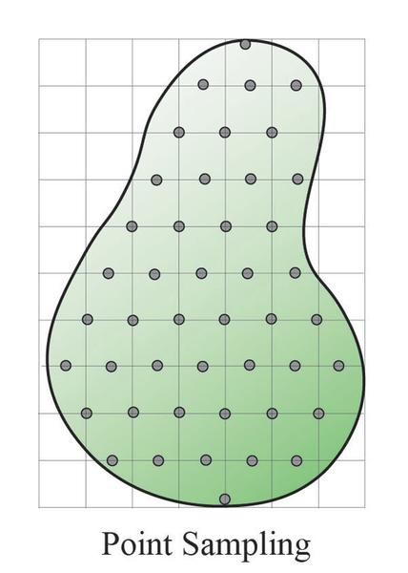
Introduction
Obtaining environmental data in space and time is a challenging task.
This is also observed for radon
Non-linearity and complexity of environmental systems especially sub-surface are often done with modelling strategies which require a specific set of variables and parameters
https://www.mapsofworld.com

Slide 3
Possible research pathways
Spatial Prediction
Time series Forecasting. Measurement points of interest. Limited amount of sampling points..
Parameter estimation. e,.g missing data in a measurement location. Dependent and independent variables

Slide 4
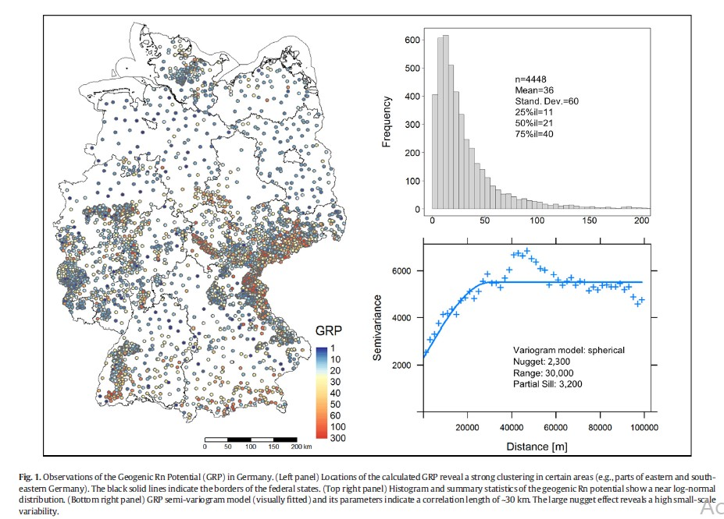
Spatial Prediction
E.g Peterman et. Al
4400 measuring points. (Whole of Germany)
(status November 2019)

Slide 5
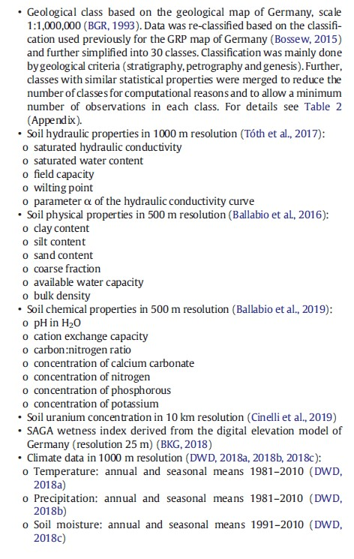
Data set
Data set required
Geological,
Soil Hydraulic properties
Soil physical Properties
Soil Chemical properties
Soil Uranium concenbtration
SAGA Wetness Index
Climate Data

Slide 6
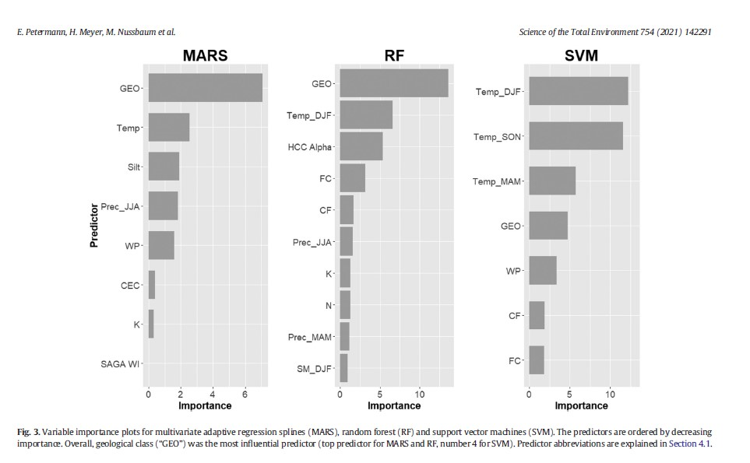
Modelling Strategies
Models used
Multivariate adaptive regression splines MARS
Support Vector Machines
Random Forest

Slide 7
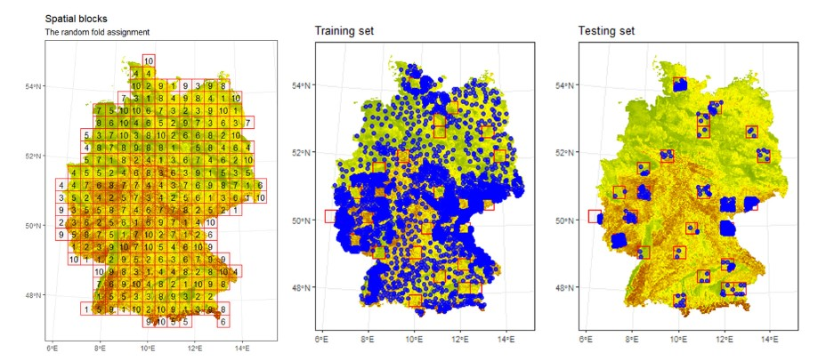
Model validation

Slide 8


